Slide 1
MINE-DETECTION DRONE

Slide 2
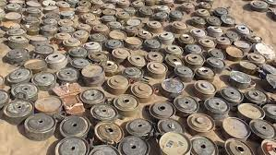

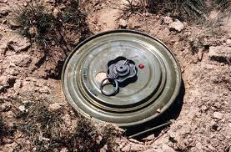
The Problem
The number of types of anti-personnel and anti-tank mines laid by Allied and Axis forces in Egypt's western desert during World War II.

Slide 3
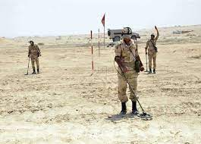
Traditional ways to solve the problem
Searching the ground: The process of searching for mines in the ground with a stick or bayonet has been going on for several years, with trained soldiers probing the ground very lightly with a bayonet, even though one mistake could cost their lives.

Slide 4
Trained dogs: Trained dogs are one of the means of detecting mines by inhaling the fumes from the explosive components inside the mines.

Slide 5
Metal detectors: It is a method with limited capabilities in picking up mines, because there are many mines made of plastic with very small amounts of metal.

Slide 6
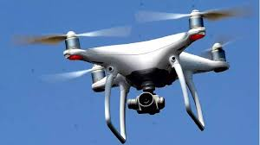
Our solution
Using a drone to detect and extract mines

Slide 7
steps
The drone flies, scans the ground and takes pictures.
The cameras analyze the images and extract data from them.
The program takes this data and sends it to the machine learning model.
The machine learning model predicts, based on the data sent to it, whether this place contains a mine or not.
Then the drone extracts the mine in a safe way, as the person controls it remotely.

Slide 8


part of the code

Slide 9



Slide 10

the program

Slide 11


Slide 12



Slide 13
Team members(Space x)
Islam Abd_Elhady
Marian Ashraf
Ghada Ragab

Slide 14
Thank you

